Slide 1
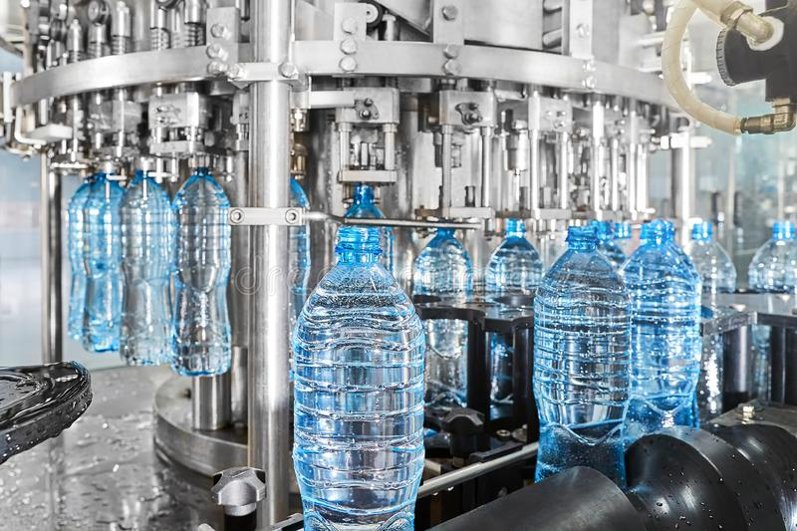
Project on Entrepreneurship
Development of MINERAL WATER
GUIDED BY :-
PRESENTED BY : -
DR. APURBA GIRI (Assistant Professor and Head)
AYAN MONDAL (Assistant Professor)
Dept. of Nutrition
Mugberia Gangadhar Mahavidyalaya
ALAKESH KHATUA
Roll: 0424
B.Voc (Food Processing, 6th Sem)
Dept. of Nutrition
Mugberia Gangadhar Mahavidyalaya

Slide 3
INTRODUCTION
The demand for mineral water has been reached to an incredible level today. As compare to regular potable water, most people are now preferred buying mineral water because of its ultimate purity and hygiene. This demand is attracting new entrepreneurs to set up mineral water business.

Slide 4
PACKAGED DRINKING WATER VS MINERAL WATER
Packaged drinking water is water derived from any source of drinking water that might be exposed to different stages of the filtration process, including cartridge filter, activated carbon filtration, or any other method.
Mineral water involves minerals that offer health-related benefits to humans. Calcium, sodium, potassium, magnesium, etc are a few such minerals generally found in mineral water.

Slide 5
MINERAL WATER MANUFUCTURING BUSINESS
REQUIREMENTS : -
INVESTMENT
LOCATION
BUSINESS RESEARCH
RAW METERIAL
MACHINES
AREA
MANPOWER
COUSTOMERS
LICENSES
PROFIT
MARKET STRATEGY

Slide 6
BUSINESS RESEARCH
DEMAND
SUPPLY
PRICE
QUANTITY
QUALITY

Slide 7
SELECT ION OF PLANT LOCTION
Establishing a workable mineral water plant seeks a minimum 1500-2000 SQ FT . The layout of the same should be tweaked in accordance with the equipment to be used in the process to maximize efficacy. If possible, select the location that comes in close proximity to the marketing distribution areas. This way, it will become easier to reduce the overall transportation cost .

Slide 8
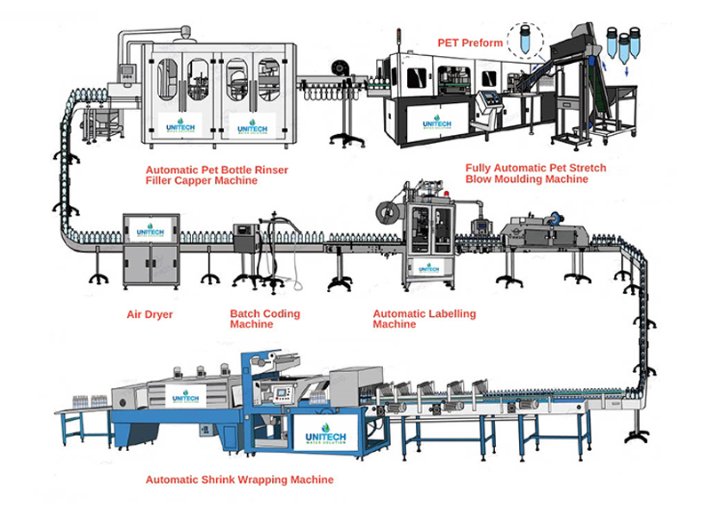
MACHINERY
RO PLANT
OZONE GENERATOR
ALUM TREATMENT TANK
CLORINATION TANK
SAND & CARBON FILTER
UV DISINFECTANT SYSTEM
RAW WATER TANK
PUMPING MOTORS
AUTOMATIC FILLING MACHINE
SEALING & LABELING MECHINE
LABORATORY EQUIPMENT
OTHER TOOLS

Slide 9
LICENCESE
BUSINESS REGISTRATION
NOC( for ground water withdrawal) FORM STATE POLLUTION CONTROL BOARD
TRADE LICENSE (MUNICIPAL
AUTHORITY)
GST (Goods and Services Tax)NUMBER
FASSI
BIS(Bureau of Indian Standards)
TRADEMARK

Slide 10
INVESTMENT
30 - 40 lakhs including total all cost
PROFIT
Depending on production & business model
MANPOWER
12 – 15 LABOURS

Slide 11
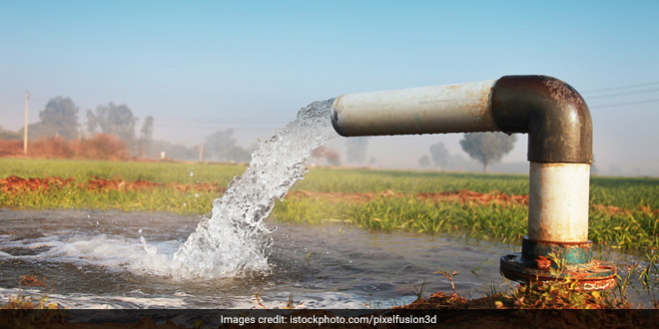
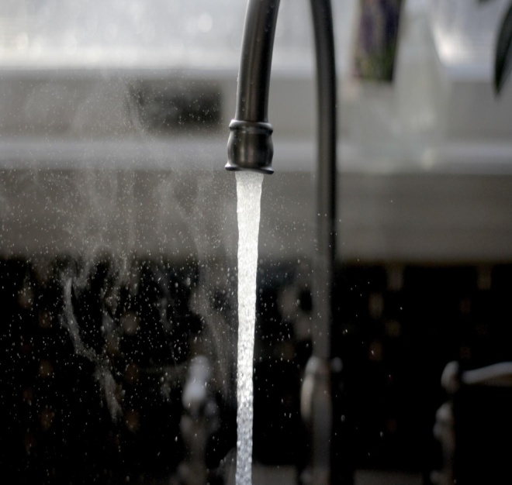
RAW METERIAL
WATER:-
Underground water
Municipal supplied water
The typical raw material required at the water purification plant
Reagents
Bottles
Chemical
Bottle caps
Cartons
Pouches

Slide 12
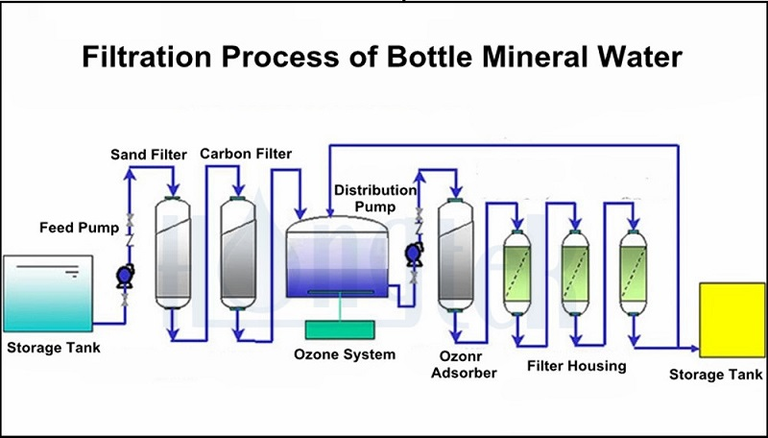
Added chlorine
MMICRO FILTER

Slide 13
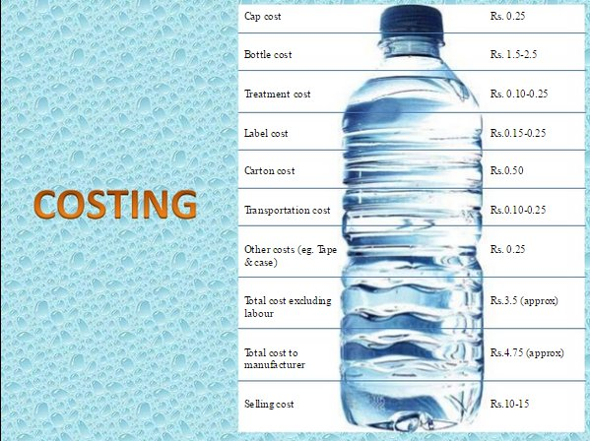
PRODUCTION COST OF PER 1 LITER BOTTLE WATER
Total cost approx
10 rupees per liter
Selling price
15 rupees
TOTAL PROFIT:-
15-10=5 rupees

Slide 14
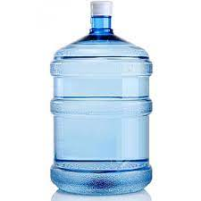
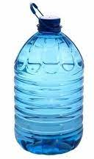
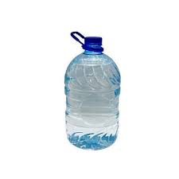
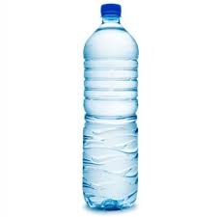
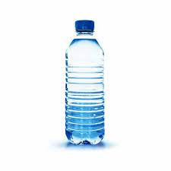
PACKAGING SIZES :-
500 ML
1LITER
2 LITER
5 LITER
10 LITER

Slide 15
TARGET COUSTOMERS
WHOLEESALERS
RETAILORS
GENERAL STORES
SUPERMARKET
RESTAURANTS & HOTELS
ONLINE
OTHERS

Slide 16
MARKETING STRATEGIES
Publicity
Advertising
Sales promotion
Direct marketing
SPECIAL DISCOUNT %

Slide 17
PLANT LAYOUT OF A.K MINERAL WATER.
Electric supply room
Wash room
Packaging area
Bath room
Storage room
Staff room
Production
room
Office room
Entry
Raw water
laboratory

Slide 18
CONCLUSION
Production of mineral water is a complicated process where the raw water undergoes various filtrations and disinfects process stages. The cost of setting up a mineral water plant is also proportional to the volume of pure water to produce. Therefore, its research very important to dig down and avail more clarity on This business goal before pouring hard-earned money into this venture.

Slide 19
THANK
YOU

